Slide 1
CS-521 Data Mining Techniques Otto Group Product Classification Challenge
Harish Dara
Vamshi Krishna N S
Maheswarareddy Durgempudi

Slide 2
Project Description
Problem Definition:
The Otto Group is one of the world’s biggest e-commerce companies which sells millions of products worldwide, with several thousand products being added to product line.
A consistent analysis of the performance of products is crucial. However, due to diverse global infrastructure, many identical products get classified differently.
The quality of product analysis depends heavily on the ability to accurately cluster similar products.
The better the classification, the more insights the company can generate about product range.
So need to develop a classifier which predicts the product group based on the given features accurately.

Slide 3
Project Description
Data Description:
Data consists of training data and test data files. The data fields present in data files are described as below:
id - an anonymous id unique to a product
feat_1, feat_2, ..., feat_93 - the various features of a product
target - the class of a product (present only in train data)
Each row corresponds to a single product.
There are a total of 93 numerical features and the data doesn’t consist of any nominal, binary, ordinal variables.
All are positive integer values and no negatives are present.
There are nine categories for all products. Each target category represents one of most important product categories (like fashion, electronics, etc.).
The products for the training and testing sets are selected randomly.

Slide 4
Top method
This is a completed competition in Kaggle. The approach followed by the team which secured 4th position in Leaderboard is:
Method followed : Stacking
Stacking is a way of combining multiple models. We train a learning algorithm to combine the predictions of several other training algorithms.
There 3 steps followed by the team are
Build models for stacking: They have chosen 18 algorithms (knn,h2o,xgboost etc...) to calculate models for stacking. For all these algorithms they have obtained predictions for the given dataset.
1st level ensembles : Based on the kaggle scores obtained for the algorithms used in the above step, they have selected gradient boosting trees, XGBoost and neural networks for the first level ensemble. Set of all predictions obtained in the above step is used as input for this step.
2nd level ensembles: The final ensemble was a geometric linear combination of methods used in the previous step.
2nd level ensembles
Describe the method that any one of the top 10 teams used
Describe what they did and why
Describe how they did and how long did it take

Slide 5
Our method
We have implemented the following algorithms:
Random Forest
XGBoost
We have chosen ensemble methods (i.e. Random Forest and XGBoost). Each method is a collection of classifiers and performs better than a single classifier.
We trained Random Forest classifier using the Train Dataset and classified the test data.
Visualizing the performance of classifier for various input parameter values we found the best fit for ntree and Mtry parameters.
We later choose XGBoost classifier, divided the input train data into 3 folds, trained the classifier, predicted the test data.
We observed the change in classifier performance for various combination of tuning parameters (nrounds, eta)
Later we calculated the linear combination of predictions of Random Forest classifier and XGBoost classifier to check for an increase in accuracy.

Slide 6
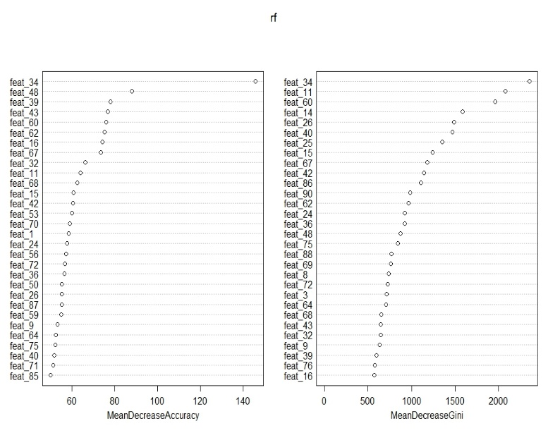
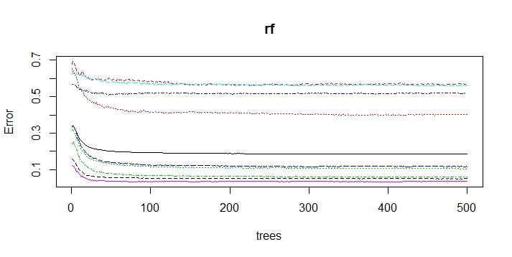
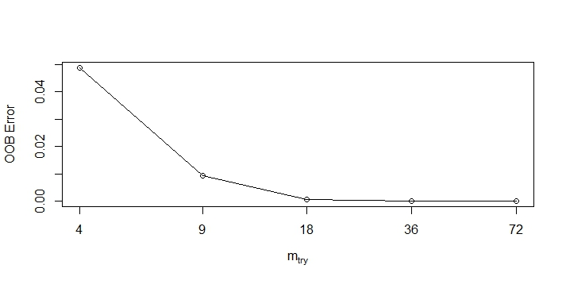
Discussions and Observations
Random Forest:
The first graph displays the feature importance and second displays the error variation w.r.t to ntree parameter value and the third displays the variation of error w.r.t to Mtry parameter.
We could see no large variation in error value with the increase of ntree value.
Feature_34 is the important feature among all 93 features.
There is large variation in OOB error when the Mtry value has been increased from 4 to 9.

Slide 7
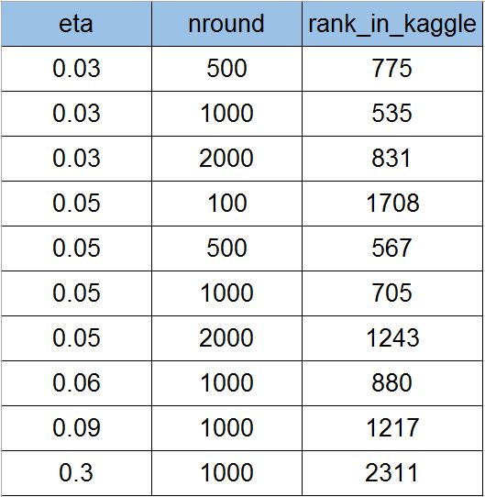
Discussions and Observations
XGBoost:
The above table displays the variation in Kaggle rank w.r.t change in parameters Shrinkage and Boosting iterations (eta, nround respectively)
We obtained 535 rank (out of 3514 teams) for combination of (eta =0.03 and nround=1000).
Running time for XGBoost classifier is 11 mins and 56 secs.
Given more time we can combine many other classifiers and increase the accuracy.

Slide 8
Contribution
Harish (40%)
Trained XGBoost Classifier.
Ran XGBoost classifier varying the input parameters.
Explored various classification algorithms to choose classifier.
Vamshi (30%)
Trained RandomForest Classifier.
Went through XGBoost documentation and explained team members.
Helped teammates in achieving their tasks.
Mahesh (30%)
Found performance variation in RandomForest Classifier and found the best fit input values.
Went through RandomForest documentation.
Analyzed the Results and prepared the presentation.

Slide 9
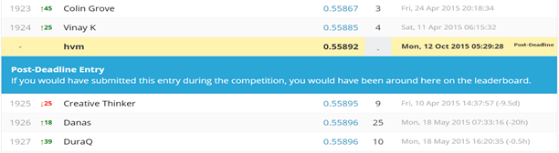
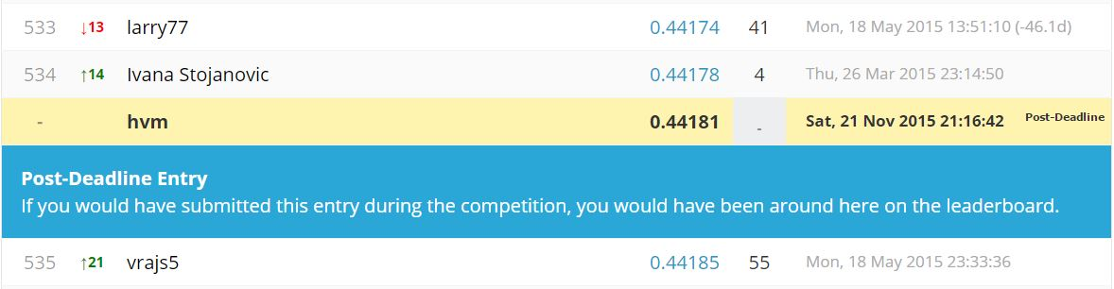
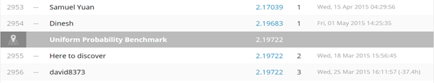
Leaderboard
Number of teams participated: 3514
Team name in Kaggle for this competition: hvm
Initial Rank using Random Forest classifier: 1925
Final Rank using XGBoost classifier : 535
Rank at Uniform Probability Benchmark: 2955

Slide 10
Miscellaneous
Using ensemble methods we can produce better results than using single classifier.
Tuning Parameters helps to decrease running time and produce better results.

